Slide 1
BME 790 Spring 2017 Weekly Summary
Author: Daniel A Hagen
Week: 03/10/17-03/17/17 Review of Babikian, S., Valero-Cuevas, F. J., Kanso, E., 2016. Slow Movements of Bio-Inspired Limbs. Journal of Nonlinear Science 26, 1293-1309.

Slide 2
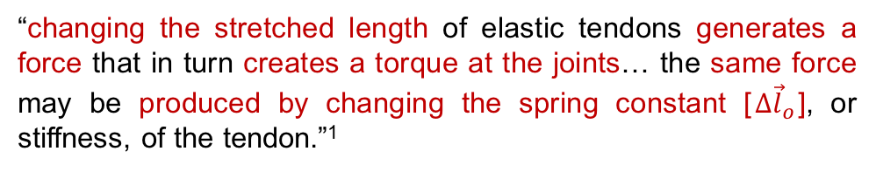
Abstract
Utilizing a driftless mechanical system where movement is controlled solely by tuning tendons’ stiffness parameters, this paper aims to answer three questions:
Is it possible to achieve slow limb movements?
Is pretensioning of the tendons necessary?
How are these movements affected by how well stiffness can be modulated?
“changing the stretched length of elastic tendons generates a force that in turn creates a torque at the joints… the same force may be produced by changing the spring constant [$Δ{\vec{l}}_{o}$], or stiffness, of the tendon.”¹
Altering tendon stiffness to produce equilibrium limb postures does not allow for a unique solution as the system is underdetermined.
To address these aims, it was assumed that each tendon acted as a linear spring with a variable spring constant (or stiffness). Additionally, the tendons would be pretensioned by some amount so as to not go slack at any posture.
Note: The same posture can be achieved at varying levels of tendon stiffness (i.e., different levels of co-contraction).

Slide 3

Strain Energy Formulation
In line with considering tendons as springs, deformation induced by a desired change in tendon length creates strain energy. The overall strain energy of the system is then calculated as:
Which resembles the familiar equation $U=\frac{1}{2}kΔx^{2}$ for a system with a spring.
Briefly defined earlier, any slow movement away from a reference posture by some small change in joint angles results in an equilibrium posture if it satisfies:
(where $\vec{φ}\left(\vec{θ}\right)$ represents any external torques on the system, such as the torques due to gravity)
As these movements are considered quasi-static (i.e., movements that are made only to nearby equilibrium postures where $Δθ$is very small) it is claimed that finding a K to satisfy the equilibrium condition (2) is equivalent to finding the minimum strain energy (1) associated with that transition. The next slides shows, however that this is only true when the external torques are considered negligible.
Therefore, by minimizing E over all K, it is possible to find a unique solution of stiffness values that produce the desired – nearby – transition to the next equilibrium posture.

Slide 4
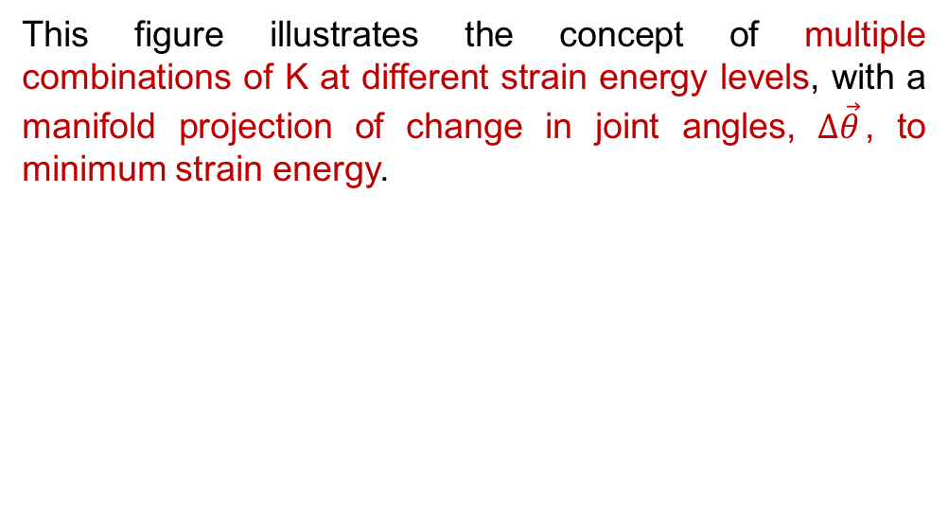
Strain Energy Formulation
This figure illustrates the concept of multiple combinations of K at different strain energy levels, with a manifold projection of change in joint angles, $Δ\vec{θ}$, to minimum strain energy.

Slide 5
Therefore, the strain energy is at an extrema (possibly a minima) when the total torques induced by the muscle forces equal zero for every joint. This does not necessarily satisfy
unless,
This can be assumed for quasi-static movements of small systems (e.g., the finger) where the external torques, like the ones due to gravity, are negligible.

Slide 6
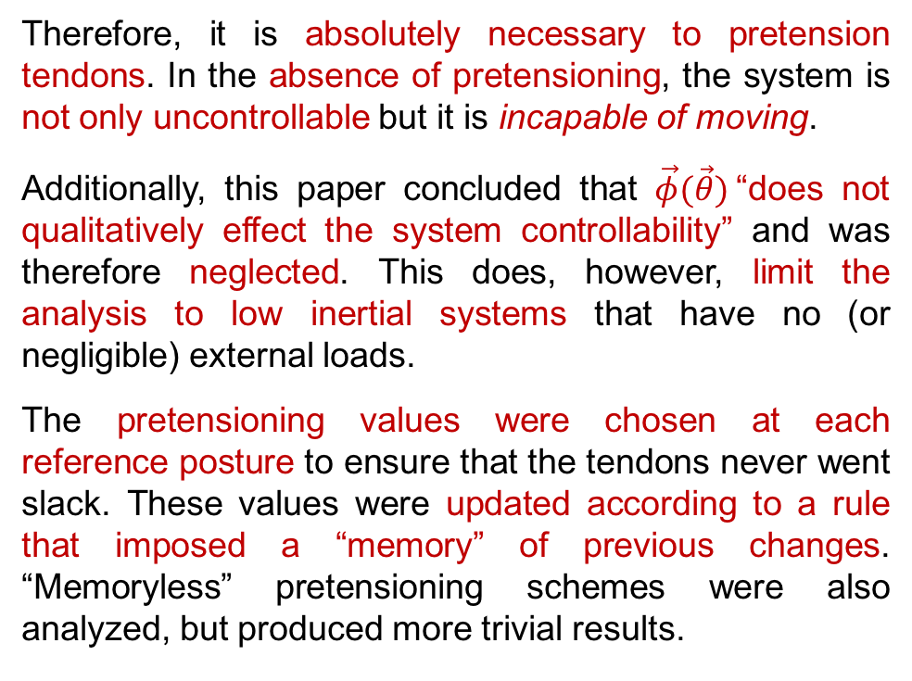
Pretensioning
Note on pretensioning:
Therefore, it is absolutely necessary to pretension tendons. In the absence of pretensioning, the system is not only uncontrollable but it is incapable of moving.
Additionally, this paper concluded that $\vec{φ}(\vec{θ})$“does not qualitatively effect the system controllability” and was therefore neglected. This does, however, limit the analysis to low inertial systems that have no (or negligible) external loads.
The pretensioning values were chosen at each reference posture to ensure that the tendons never went slack. These values were updated according to a rule that imposed a “memory” of previous changes. “Memoryless” pretensioning schemes were also analyzed, but produced more trivial results.

Slide 7
Model Considered
Here a 2-DOF, planar model was considered with 4 multi-articulating muscles. Both constant and posture dependent moment arm matrices were utilized with excursion relationships defined as:
The workspace of the finger was defined as:

Slide 8
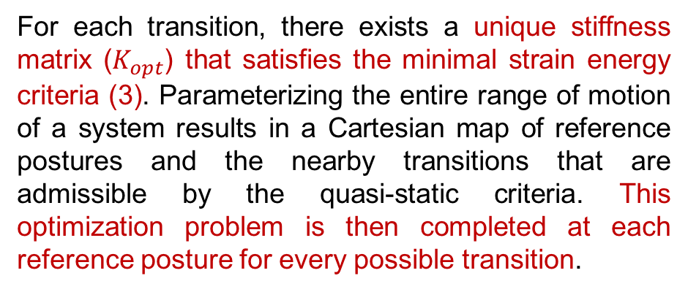
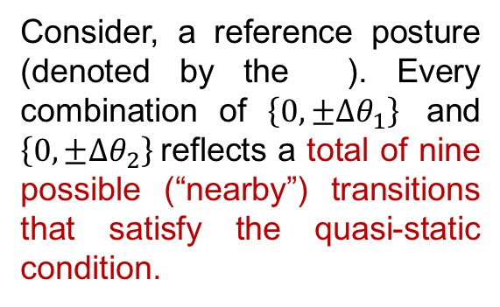
Optimality Problem
Consider, a reference posture (denoted by the ). Every combination of $\left\{0,±Δθ_{1}\right\}$ and $\left\{0,±Δθ_{2}\right\}$reflects a total of nine possible (“nearby”) transitions that satisfy the quasi-static condition.
⊗
Shape Space Manifold
and
Resulting Range of Motion
Constant
Moment Arms
For each transition, there exists a unique stiffness matrix ($K_{opt}$) that satisfies the minimal strain energy criteria (3). Parameterizing the entire range of motion of a system results in a Cartesian map of reference postures and the nearby transitions that are admissible by the quasi-static criteria. This optimization problem is then completed at each reference posture for every possible transition.
Posture-Dependent
Moment Arms

Slide 9
Optimality Problem
Note that in the case of constant moment arms, the initial reference posture does not affect the optimal stiffness parameters that result in a given transition direction. Muscles 1 and 3 do not exhibit changes in stiffness parameters regardless in any transition direction. But muscles 2 and 4 appear to balance each other, with the stiffness of one decreasing as the other increases.
These relationships are also seen in the case of posture-dependent moment arms, but now the initial reference posture dictates the resulting tendon excursions across the configuration space which directly affects the equilibrium condition and the strain energy formula – therefore changing the optimal stiffness parameters.

Slide 10
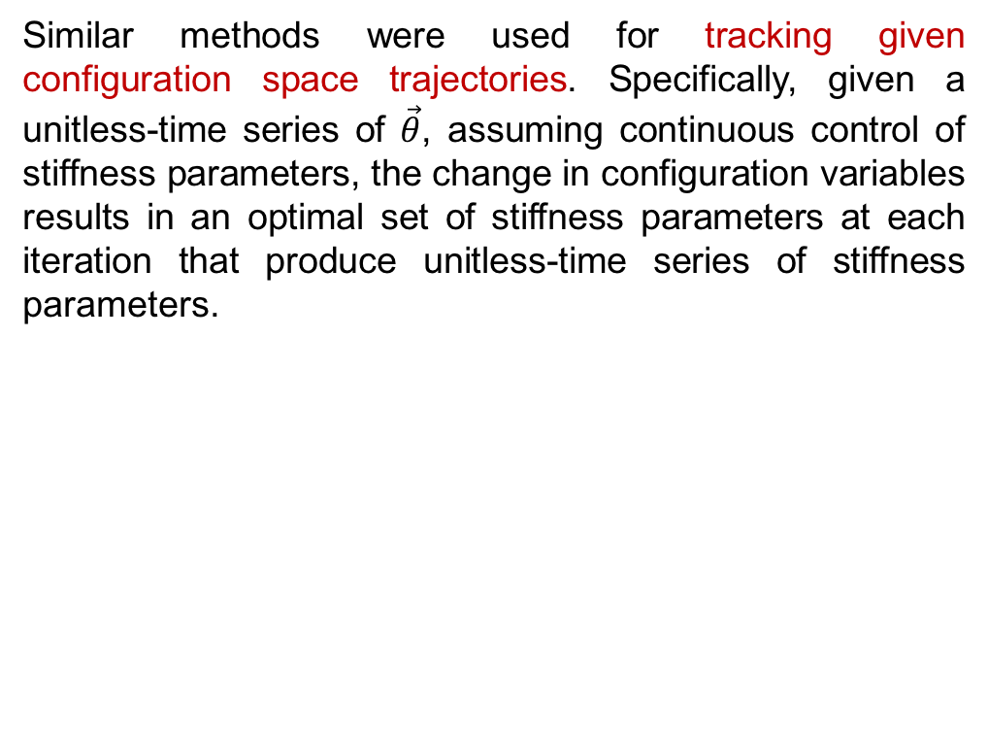
Optimality Problem with Desired Trajectories
Similar methods were used for tracking given configuration space trajectories. Specifically, given a unitless-time series of $\vec{θ}$, assuming continuous control of stiffness parameters, the change in configuration variables results in an optimal set of stiffness parameters at each iteration that produce unitless-time series of stiffness parameters.
Adjusting the pretensioning and moment arm values to be either posture dependent or constant reveals that the control of stiffness parameters becomes smoother for posture dependent control parameters.

Slide 11
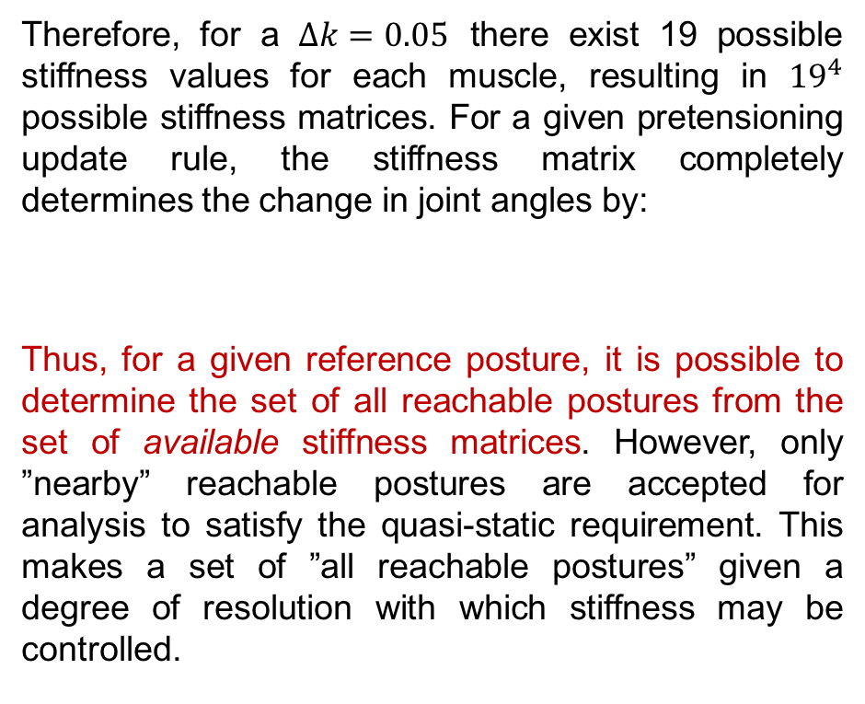
Reachability Problem
Previous analysis was conducted under the assumption that the stiffness of a given muscle could be continuously adjusted over the range of stiffness values. To investigate the effects of changes in the resolution of potential stiffness values, varying degrees of granularity were imposed on the possible stiffness values and comparisons were made between desired trajectories and the resulting trajectories induced by the available stiffness values.
Assume that the possible stiffness values that a muscle can experience are between 0.1 and 1 (normalized stiffness units). Enforcing varying sampling ratios on this set produce truncated sets of stiffness values with varying resolutions. Specifically,
Therefore, for a $Δk=0.05$ there exist 19 possible stiffness values for each muscle, resulting in ${19}^{4}$ possible stiffness matrices. For a given pretensioning update rule, the stiffness matrix completely determines the change in joint angles by:
Thus, for a given reference posture, it is possible to determine the set of all reachable postures from the set of available stiffness matrices. However, only ”nearby” reachable postures are accepted for analysis to satisfy the quasi-static requirement. This makes a set of ”all reachable postures” given a degree of resolution with which stiffness may be controlled.

Slide 12
Reachability Problem
For a given desired trajectory they postulate that the system will select the “nearest” reachable posture along that trajectory as it progresses along. For decreased resolution systems, the nearest reachable postures will be farther that those of with higher resolution. Thus the transition between “equilibrium postures” will result in large “jumps” which produce rigid non-smooth movement trajectories.
They make the point that controllability of stiffness parameters dictates the smoothness of slow movements by altering the proximity of the nearest equilibrium posture along a desired movement direction.
As the resolution increases left to right, the set of “reachable postures” becomes a larger subset of the range of motion of the system and as a result the achieved (nearest) equilibrium postures will more closely approximate the desired transitions.

Slide 13
Conclusions/Impressions
This paper demonstrated the need to pretensioning of tendons to allow for complete controllability of a system. Additionally, they made the point that for posture-dependent moment arm values, the optimal stiffness values (over the minimal strain energy) not only change as a function of “nearby” transition direction but also vary across the range of motion of the system. They also present a interesting formulation of calculating the required stiffness values over a given gait cycle that would be interesting to replicate using differential geometric techniques.
One note, however, on the formulation of these techniques and on the set of all “reachable” postures. As external torques were neglected, this optimal stiffness formulation will change – solving the equilibrium constraint will no longer coincide with the minimum of the strain energy cost function. Therefore this analysis is only applicable to small, driftless systems that have low inertia and no external loads. Additionally, the formulation for the set of all reachable postures utilizes a reference-posture-centric technique that finds the set of “reachable” postures when deviating from a reference posture (with only transitions “nearby” being considered) and not the set of reachable postures in the range of motion (based on all available stiffness values). This assumes that the system only makes transitions between reference postures when the set of “reachable” postures intersects the next reference posture along the desired trajectory.
References:
Babikian, S., Valero-Cuevas, F. J., Kanso, E., 2016. Slow Movements of Bio-Inspired Limbs. Journal of Nonlinear Science 26, 1293-1309.

